Slide 1

AdventureWorks
Teamates: Medha Devalraj
Mohammod Yusuf Qidwai
Harshwardhan Patil
Tanvi Amlani

Slide 2

Project Overview
Description:
Developing a comprehensive SQL-based sales data warehouse for AdventureWorks, a leading bicycle manufacturing and sales company.
Objective: To address data management challenges and support data-driven decision-making through robust database architecture.
Key Features:
Snowflake schema design.
Integration of sales, inventory, and purchasing data.
Enhanced query performance and data integrity.

Slide 3
Scope
Core Development: Design and implement a scalable SQL database.
Schema Architecture: Employ fact and dimension tables with a snowflake schema.
Focus Areas:
Sales transaction tracking.
Inventory control and purchase order management.
Customer relationship management and product hierarchy.
Territory and location management.
Technical Implementation:
SQL Server database, query optimization, and performance tuning.
Data integration with existing systems for a seamless operational workflow.

Slide 4
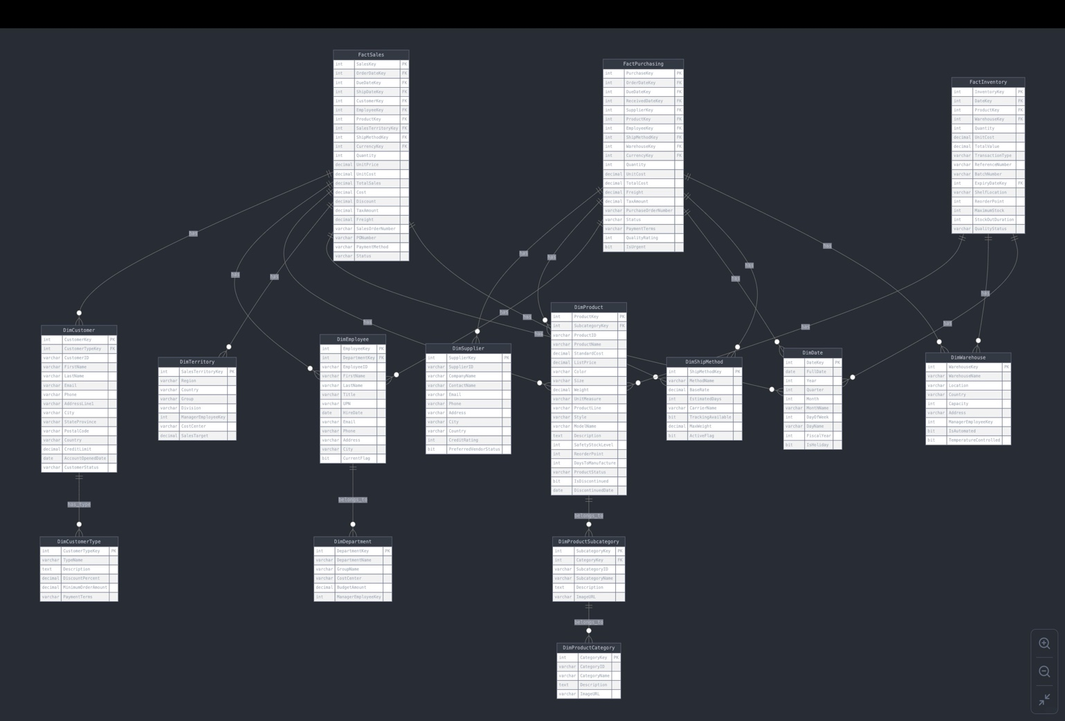

Slide 5

Queries and Tables

Slide 6
FactSales
Attribute | Data Type | Key Type | Description
SalesKey | INT | PK | Unique identifier for each sales transaction
OrderDateKey | INT | FK | Reference to date dimension for order date
DueDateKey | INT | FK | Reference to date dimension for due date
ShipDateKey | INT | FK | Reference to date dimension for ship date
CustomerKey | INT | FK | Reference to customer dimension
EmployeeKey | INT | FK | Reference to employee who processed the sale
ProductKey | INT | FK | Reference to product dimension
SalesTerritoryKey | INT | FK | Reference to sales territory dimension
ShipMethodKey | INT | FK | Reference to shipping method dimension
CurrencyKey | INT | FK | Reference to currency dimension
Quantity | INT |  | Number of units sold
UnitPrice | DECIMAL |  | Price per unit
UnitCost | DECIMAL |  | Cost per unit
TotalSales | DECIMAL |  | Total sales amount
Cost | DECIMAL |  | Total cost amount
Discount | DECIMAL |  | Discount amount applied
TaxAmount | DECIMAL |  | Tax amount
Freight | DECIMAL |  | Shipping cost
SalesOrderNumber | VARCHAR |  | Unique sales order identifier
PONumber | VARCHAR |  | Purchase order number from customer
PaymentMethod | VARCHAR |  | Method of payment
Status | VARCHAR |  | Current status of the order
CREATE TABLE FactSales ( SalesKey INT IDENTITY(1,1) PRIMARY KEY,
OrderDateKey INT FOREIGN KEY REFERENCES DimDate(DateKey),
DueDateKey INT FOREIGN KEY REFERENCES DimDate(DateKey),
ShipDateKey INT FOREIGN KEY REFERENCES DimDate(DateKey),
CustomerKey INT FOREIGN KEY REFERENCES DimCustomer(CustomerKey),
EmployeeKey INT FOREIGN KEY REFERENCES DimEmployee(EmployeeKey),
ProductKey INT FOREIGN KEY REFERENCES DimProduct(ProductKey),
SalesTerritoryKey INT FOREIGN KEY REFERENCES DimTerritory(SalesTerritoryKey),
ShipMethodKey INT FOREIGN KEY REFERENCES DimShipMethod(ShipMethodKey),
Quantity INT, UnitPrice DECIMAL(18,2), UnitCost DECIMAL(18,2),
TotalSales DECIMAL(18,2), Cost DECIMAL(18,2), Discount DECIMAL(18,2),
TaxAmount DECIMAL(18,2), Freight DECIMAL(18,2), SalesOrderNumber VARCHAR(20),
PONumber VARCHAR(20), PaymentMethod VARCHAR(20), Status VARCHAR(20) );

Slide 7
FactPurchasing
Attribute | Data Type | Key Type | Description
PurchaseKey | INT | PK | Unique identifier for each purchase transaction
OrderDateKey | INT | FK | Reference to date dimension for order date
DueDateKey | INT | FK | Reference to date dimension for due date
ReceivedDateKey | INT | FK | Reference to date dimension for receive date
SupplierKey | INT | FK | Reference to supplier dimension
ProductKey | INT | FK | Reference to product dimension
EmployeeKey | INT | FK | Reference to employee who processed the purchase
ShipMethodKey | INT | FK | Reference to shipping method dimension
WarehouseKey | INT | FK | Reference to warehouse dimension
CurrencyKey | INT | FK | Reference to currency dimension
Quantity | INT |  | Number of units purchased
UnitCost | DECIMAL |  | Cost per unit
TotalCost | DECIMAL |  | Total cost amount
Freight | DECIMAL |  | Shipping cost
TaxAmount | DECIMAL |  | Tax amount
PurchaseOrderNumber | VARCHAR |  | Unique purchase order identifier
Status | VARCHAR |  | Current status of the purchase order
PaymentTerms | VARCHAR |  | Payment terms agreed with supplier
QualityRating | INT |  | Quality rating of received goods (1-5)
IsUrgent | BIT |  | Flag for urgent orders
CREATE TABLE FactPurchasing (
PurchaseKey INT IDENTITY(1,1) PRIMARY KEY, OrderDateKey INT FOREIGN KEY REFERENCES DimDate(DateKey),
DueDateKey INT FOREIGN KEY REFERENCES DimDate(DateKey), ReceivedDateKey INT FOREIGN KEY REFERENCES DimDate(DateKey),
SupplierKey INT FOREIGN KEY REFERENCES DimSupplier(SupplierKey),
ProductKey INT FOREIGN KEY REFERENCES DimProduct(ProductKey),
EmployeeKey INT FOREIGN KEY REFERENCES DimEmployee(EmployeeKey),
ShipMethodKey INT FOREIGN KEY REFERENCES DimShipMethod(ShipMethodKey),
WarehouseKey INT FOREIGN KEY REFERENCES DimWarehouse(WarehouseKey),
Quantity INT, UnitCost DECIMAL(18,2), TotalCost DECIMAL(18,2), Freight DECIMAL(18,2), TaxAmount DECIMAL(18,2),
PurchaseOrderNumber VARCHAR(20), Status VARCHAR(20), PaymentTerms VARCHAR(50), QualityRating INT, IsUrgent BIT
);

Slide 8
FactInventory
Attribute | Data Type | Key Type | Description
InventoryKey | INT | PK | Unique identifier for each inventory record
DateKey | INT | FK | Reference to date dimension
ProductKey | INT | FK | Reference to product dimension
WarehouseKey | INT | FK | Reference to warehouse dimension
Quantity | INT |  | Current quantity in stock
UnitCost | DECIMAL |  | Cost per unit
TotalValue | DECIMAL |  | Total inventory value
TransactionType | VARCHAR |  | Type of inventory transaction
ReferenceNumber | VARCHAR |  | Reference to related transaction
BatchNumber | VARCHAR |  | Production batch number
ExpiryDateKey | INT | FK | Reference to date dimension for expiry date
ShelfLocation | VARCHAR |  | Storage location in warehouse
ReorderPoint | INT |  | Minimum quantity to trigger reorder
MaximumStock | INT |  | Maximum allowed quantity
StockOutDuration | INT |  | Duration of stock-out in hours
QualityStatus | VARCHAR |  | Current quality status of inventory
CREATE TABLE FactInventory (
InventoryKey INT IDENTITY(1,1) PRIMARY KEY,
DateKey INT FOREIGN KEY REFERENCES DimDate(DateKey),
ProductKey INT FOREIGN KEY REFERENCES DimProduct(ProductKey),
WarehouseKey INT FOREIGN KEY REFERENCES DimWarehouse(WarehouseKey),
Quantity INT, UnitCost DECIMAL(18,2), TotalValue DECIMAL(18,2),
TransactionType VARCHAR(20), ReferenceNumber VARCHAR(20),
BatchNumber VARCHAR(20),
ExpiryDateKey INT FOREIGN KEY REFERENCES DimDate(DateKey),
ShelfLocation VARCHAR(20), ReorderPoint INT, MaximumStock INT,
StockOutDuration INT, QualityStatus VARCHAR(20)
);

Slide 9
DimProduct
Attribute | Data Type | Key Type | Description
ProductKey | INT | PK | Unique identifier for each product
SubcategoryKey | INT | FK | Reference to product subcategory
ProductID | VARCHAR |  | Business identifier for the product
ProductName | VARCHAR |  | Name of the product
StandardCost | DECIMAL |  | Standard manufacturing cost
ListPrice | DECIMAL |  | Suggested retail price
Color | VARCHAR |  | Product color
Size | VARCHAR |  | Product size
Weight | DECIMAL |  | Product weight
UnitMeasure | VARCHAR |  | Unit of measurement
ProductLine | VARCHAR |  | Product line category
Style | VARCHAR |  | Style classification
ModelName | VARCHAR |  | Model name
Description | TEXT |  | Detailed product description
SafetyStockLevel | INT |  | Minimum safety stock quantity
ReorderPoint | INT |  | Quantity triggering reorder
DaysToManufacture | INT |  | Production time in days
ProductStatus | VARCHAR |  | Current product status
IsDiscontinued | BIT |  | Discontinued flag
DiscontinuedDate | DATE |  | Date product was discontinued
CREATE TABLE DimProduct (
ProductKey INT IDENTITY(1,1) PRIMARY KEY,
SubcategoryKey INT FOREIGN KEY REFERENCES DimProductSubcategory(SubcategoryKey),
ProductID VARCHAR(20),
ProductName VARCHAR(100),
StandardCost DECIMAL(18,2),
ListPrice DECIMAL(18,2),
Color VARCHAR(20),
Size VARCHAR(10),
Weight DECIMAL(8,2),
UnitMeasure VARCHAR(10),
ProductLine VARCHAR(20),
Style VARCHAR(20),
ModelName VARCHAR(50),
Description TEXT,
SafetyStockLevel INT,
ReorderPoint INT,
DaysToManufacture INT,
ProductStatus VARCHAR(20),
IsDiscontinued BIT,
DiscontinuedDate DATE
);

Slide 10
DimProductSubCategory
Attribute | Data Type | Key Type | Description
SubcategoryKey | INT | PK | Unique identifier for subcategory
CategoryKey | INT | FK | Reference to product category
SubcategoryID | VARCHAR |  | Business identifier for subcategory
SubcategoryName | VARCHAR |  | Name of the subcategory
Description | TEXT |  | Detailed subcategory description
ImageURL | VARCHAR |  | URL to subcategory image
CREATE TABLE DimProductSubcategory (
SubcategoryKey INT IDENTITY(1,1) PRIMARY KEY,
CategoryKey INT FOREIGN KEY REFERENCES DimProductCategory(CategoryKey),
SubcategoryID VARCHAR(10),
SubcategoryName VARCHAR(50),
Description TEXT,
ImageURL VARCHAR(200)
);

Slide 11
DimProductCategory
Attribute | Data Type | Key Type | Description
CategoryKey | INT | PK | Unique identifier for category
CategoryID | VARCHAR |  | Business identifier for category
CategoryName | VARCHAR |  | Name of the category
Description | TEXT |  | Detailed category description
ImageURL | VARCHAR |  | URL to category image
CREATE TABLE DimProductCategory (
CategoryKey INT IDENTITY(1,1) PRIMARY KEY,
CategoryID VARCHAR(10),
CategoryName VARCHAR(50),
Description TEXT,
ImageURL VARCHAR(200)
);

Slide 12
DimCustomer
Attribute | Data Type | Key Type | Description
CustomerKey | INT | PK | Unique identifier for customer
CustomerTypeKey | INT | FK | Reference to customer type
CustomerID | VARCHAR |  | Business identifier for customer
FirstName | VARCHAR |  | Customer's first name
LastName | VARCHAR |  | Customer's last name
Email | VARCHAR |  | Customer's email address
Phone | VARCHAR |  | Customer's phone number
AddressLine1 | VARCHAR |  | Primary address
City | VARCHAR |  | City name
StateProvince | VARCHAR |  | State or province
PostalCode | VARCHAR |  | Postal code
Country | VARCHAR |  | Country name
CreditLimit | DECIMAL |  | Approved credit limit
AccountOpenedDate | DATE |  | Account creation date
CustomerStatus | VARCHAR |  | Current customer status
CREATE TABLE DimCustomer (
CustomerKey INT IDENTITY(1,1) PRIMARY KEY,
CustomerTypeKey INT FOREIGN KEY REFERENCES DimCustomerType(CustomerTypeKey),
CustomerID VARCHAR(20),
FirstName VARCHAR(50),
LastName VARCHAR(50),
Email VARCHAR(100),
Phone VARCHAR(20),
AddressLine1 VARCHAR(100),
City VARCHAR(50),
StateProvince VARCHAR(50),
PostalCode VARCHAR(20),
Country VARCHAR(50),
CreditLimit DECIMAL(18,2),
AccountOpenedDate DATE,
CustomerStatus VARCHAR(20)
);

Slide 13
DimCustomerType
CREATE TABLE DimCustomerType (
CustomerTypeKey INT IDENTITY(1,1) PRIMARY KEY,
TypeName VARCHAR(50),
Description TEXT,
DiscountPercent DECIMAL(5,2),
MinimumOrderAmount DECIMAL(18,2),
PaymentTerms VARCHAR(50)
);
Attribute | Data Type | Key Type | Description
CustomerTypeKey | INT | PK | Unique identifier for customer type
TypeName | VARCHAR |  | Name of customer type
Description | TEXT |  | Detailed type description
DiscountPercent | DECIMAL |  | Discount applicable to customer type

Slide 14
DimEmployee
Attribute | Data Type | Key Type | Description
EmployeeKey | INT | PK | Unique identifier for employee
EmployeeID | VARCHAR |  | Business identifier for employee
FirstName | VARCHAR |  | Employee's first name
LastName | VARCHAR |  | Employee's last name
Email | VARCHAR |  | Employee's email address
Phone | VARCHAR |  | Employee's phone number
HireDate | DATE |  | Hire date
PositionTitle | VARCHAR |  | Job title
DepartmentKey | INT | FK | Reference to department dimension
LocationKey | INT | FK | Reference to location dimension
IsSalesRep | BIT |  | Flag indicating if employee is a sales representative
IsManager | BIT |  | Flag indicating if employee is a manager
ReportsToKey | INT | FK | Reference to employee who they report to
EmploymentStatus | VARCHAR |  | Current employment status
CREATE TABLE DimEmployee (
EmployeeKey INT IDENTITY(1,1) PRIMARY KEY,
DepartmentKey INT FOREIGN KEY REFERENCES DimDepartment(DepartmentKey),
EmployeeID VARCHAR(20),
FirstName VARCHAR(50),
LastName VARCHAR(50),
Title VARCHAR(50),
UPN VARCHAR(100),
HireDate DATE,
Email VARCHAR(100),
Phone VARCHAR(20),
Address VARCHAR(100),
City VARCHAR(50),
CurrentFlag BIT
);

Slide 15
DimDepartment
Attribute | Data Type | Key Type | Description
DepartmentKey | INT | PK | Unique identifier for department
DepartmentID | VARCHAR |  | Business identifier for department
DepartmentName | VARCHAR |  | Name of the department
Description | TEXT |  | Detailed department description
Floor | INT |  | Floor number
ManagerKey | INT | FK | Reference to employee who manages the department
CREATE TABLE DimDepartment (
DepartmentKey INT IDENTITY(1,1) PRIMARY KEY,
DepartmentName VARCHAR(50),
GroupName VARCHAR(50),
CostCenter VARCHAR(20),
BudgetAmount DECIMAL(18,2),
ManagerEmployeeKey INT
);

Slide 16
DimDate
Attribute | Data Type | Key Type | Description
DateKey | INT | PK | Unique identifier for date
FullDate | DATE |  | Calendar date
Year | INT |  | Calendar year
Quarter | INT |  | Calendar quarter (1-4)
Month | INT |  | Month number (1-12)
MonthName | VARCHAR |  | Month name
DayOfWeek | INT |  | Day of week (1-7)
DayName | VARCHAR |  | Day name
FiscalYear | INT |  | Fiscal year
IsHoliday | BIT |  | Holiday flag
CREATE TABLE DimDate (
DateKey INT PRIMARY KEY,
FullDate DATE,
Year INT,
Quarter INT,
Month INT,
MonthName VARCHAR(10),
DayOfWeek INT,
DayName VARCHAR(10),
FiscalYear INT,
IsHoliday BIT
);

Slide 17
DimSupplier
CREATE TABLE DimSupplier (
SupplierKey INT IDENTITY(1,1) PRIMARY KEY,
SupplierID VARCHAR(20),
CompanyName VARCHAR(100),
ContactName VARCHAR(100),
Email VARCHAR(100),
Phone VARCHAR(20),
Address VARCHAR(100),
City VARCHAR(50),
Country VARCHAR(50),
CreditRating INT,
PreferredVendorStatus BIT
);
Attribute | Data Type | Key Type | Description
SupplierKey | INT | PK | Unique identifier for supplier
SupplierID | VARCHAR |  | Business identifier for supplier
CompanyName | VARCHAR |  | Supplier company name
ContactName | VARCHAR |  | Primary contact person
Email | VARCHAR |  | Contact email address
Phone | VARCHAR |  | Contact phone number
Address | VARCHAR |  | Business address
City | VARCHAR |  | City location
Country | VARCHAR |  | Country location
CreditRating | INT |  | Credit rating (1-5)
PreferredVendorStatus | BIT |  | Preferred vendor flag

Slide 18
DimWarehouse
Attribute | Data Type | Key Type | Description
WarehouseKey | INT | PK | Unique identifier for warehouse
WarehouseName | VARCHAR |  | Name of warehouse
Location | VARCHAR |  | Geographic location
Country | VARCHAR |  | Country location
Capacity | INT |  | Storage capacity
Address | VARCHAR |  | Physical address
ManagerEmployeeKey | INT |  | Reference to warehouse manager
IsAutomated | BIT |  | Automated facility flag
TemperatureControlled | BIT |  | Temperature control flag
CREATE TABLE DimWarehouse (
WarehouseKey INT IDENTITY(1,1) PRIMARY KEY,
WarehouseName VARCHAR(50),
Location VARCHAR(50),
Country VARCHAR(50),
Capacity INT,
Address VARCHAR(100),
ManagerEmployeeKey INT FOREIGN KEY REFERENCES DimEmployee(EmployeeKey),
IsAutomated BIT,
TemperatureControlled BIT
);

Slide 19
DimTerritory
Attribute | Data Type | Key Type | Description
SalesTerritoryKey | INT | PK | Unique identifier for territory
Region | VARCHAR |  | Geographic region
Country | VARCHAR |  | Country name
Group | VARCHAR |  | Territory group
Division | VARCHAR |  | Business division
ManagerEmployeeKey | INT |  | Reference to territory manager
CostCenter | VARCHAR |  | Cost center code
SalesTarget | DECIMAL |  | Annual sales target
CREATE TABLE DimTerritory (
SalesTerritoryKey INT IDENTITY(1,1) PRIMARY KEY,
Region VARCHAR(50),
Country VARCHAR(50),
[Group] VARCHAR(50),
Division VARCHAR(50),
ManagerEmployeeKey INT FOREIGN KEY REFERENCES DimEmployee(EmployeeKey),
CostCenter VARCHAR(20),
SalesTarget DECIMAL(18,2)
);

Slide 20
DimShipMethod
Attribute | Data Type | Key Type | Description
ShipMethodKey | INT | PK | Unique identifier for shipping method
MethodName | VARCHAR |  | Name of shipping method
BaseRate | DECIMAL |  | Base shipping rate
EstimatedDays | INT |  | Estimated delivery days
CarrierName | VARCHAR |  | Shipping carrier name
TrackingAvailable | BIT |  | Tracking availability flag
MaxWeight | DECIMAL |  | Maximum weight limit
ActiveFlag | BIT |  | Active method flag
CREATE TABLE DimShipMethod (
ShipMethodKey INT IDENTITY(1,1) PRIMARY KEY,
MethodName VARCHAR(50),
BaseRate DECIMAL(10,2),
EstimatedDays INT,
CarrierName VARCHAR(50),
TrackingAvailable BIT,
MaxWeight DECIMAL(10,2),
ActiveFlag BIT
);

Slide 21

Output

Slide 22
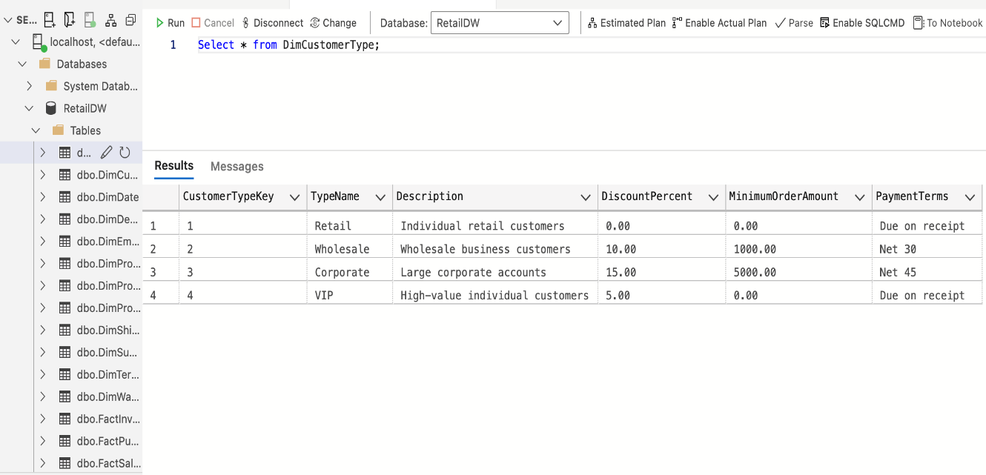
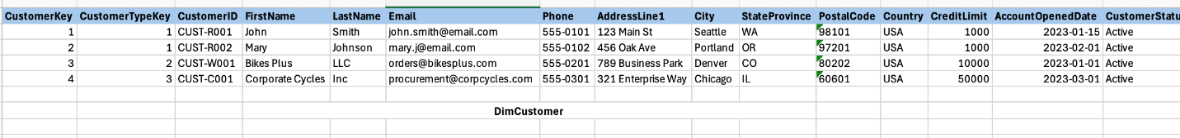
DimCustomerType
DimCustomer

Slide 23
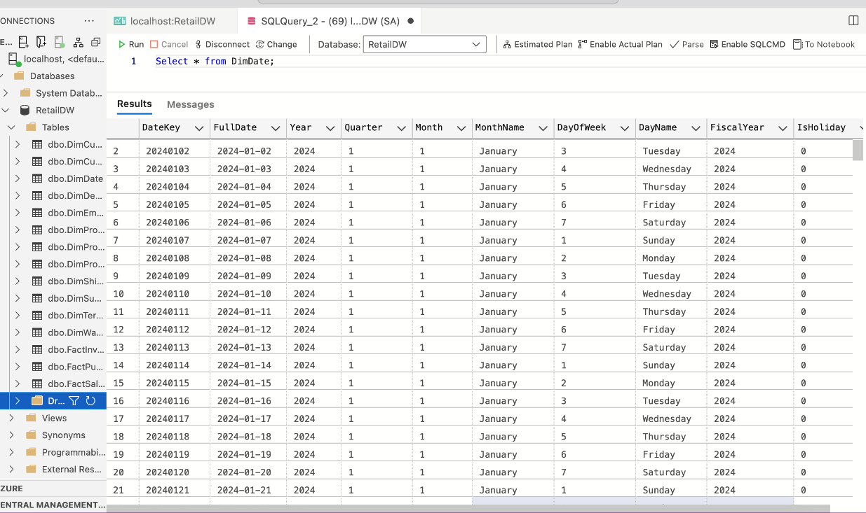
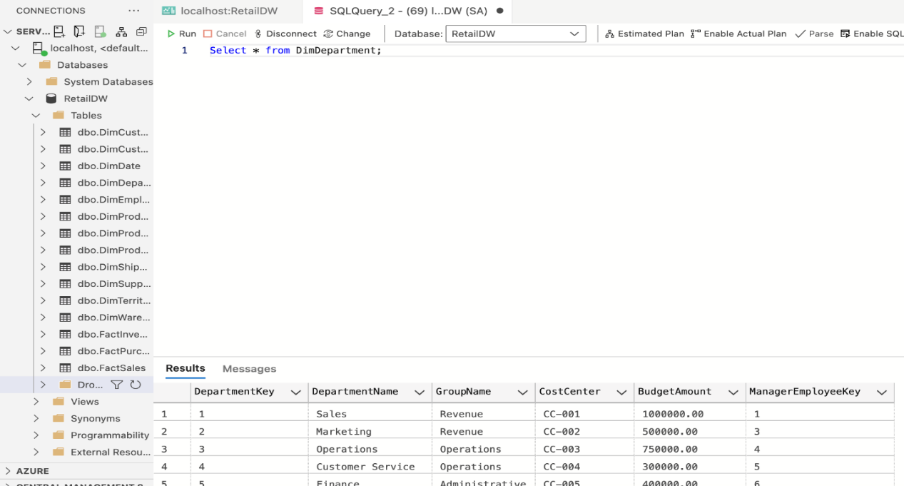
DimDate
DimDepartment

Slide 24
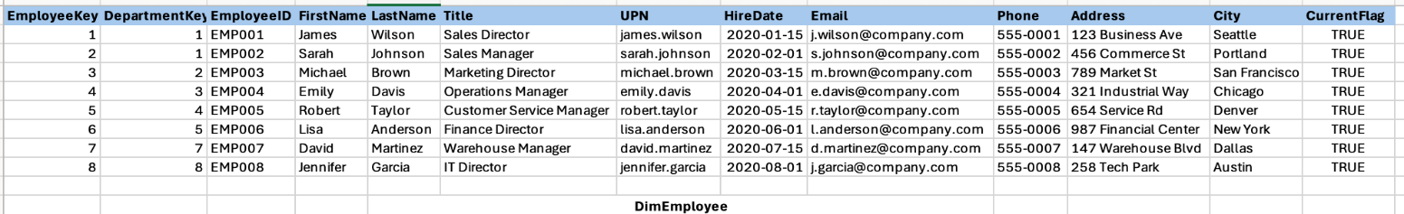
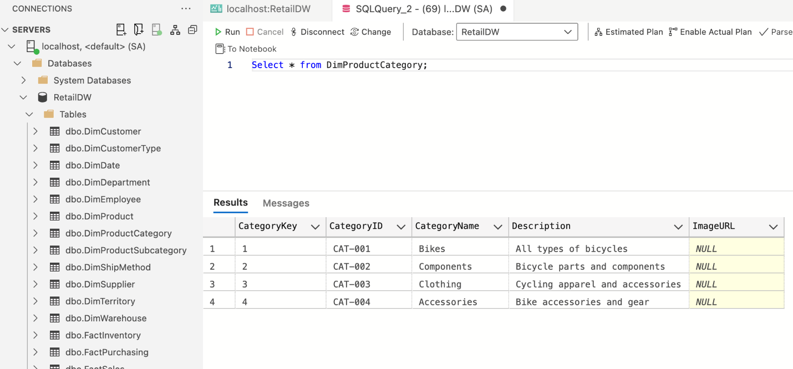
DimEmployee
DimProductCategory

Slide 25
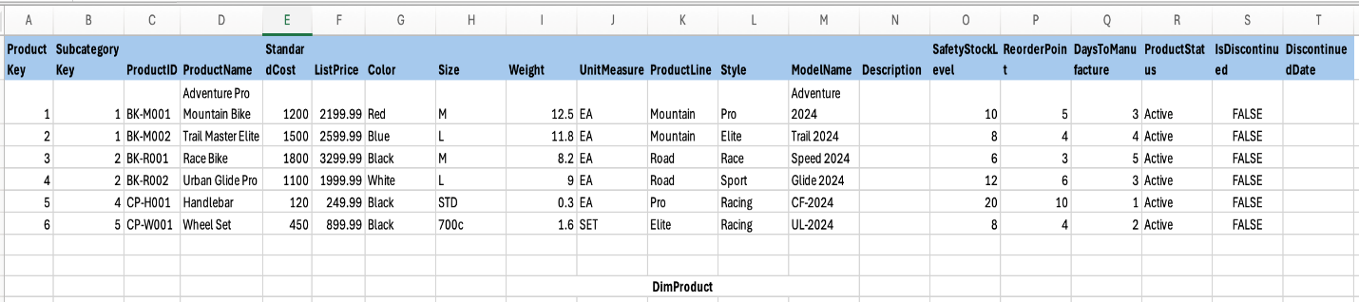
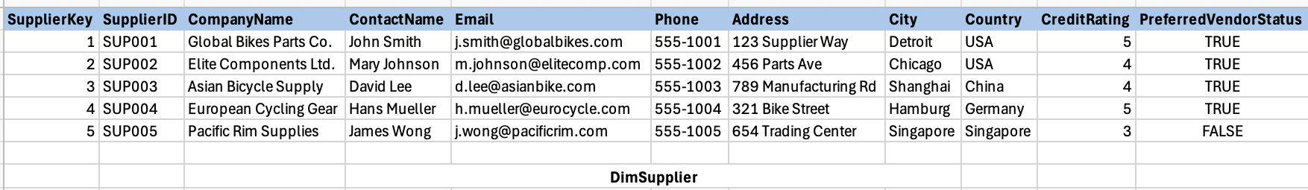
DimProduct
DimSupplier

Slide 26
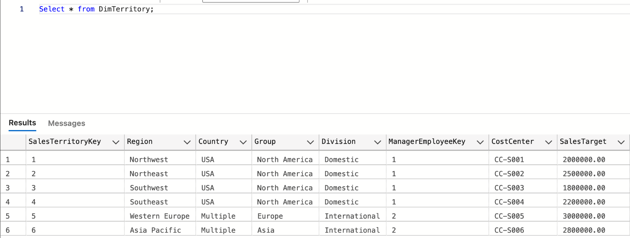
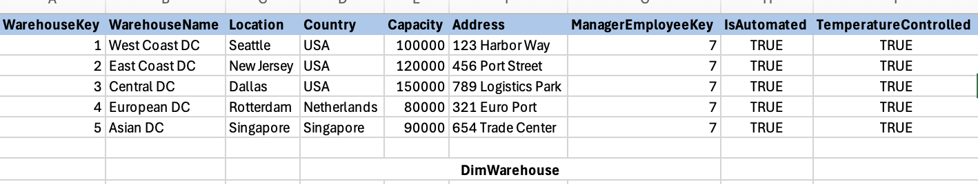
DimTerritory
DimWarehouse

Slide 27
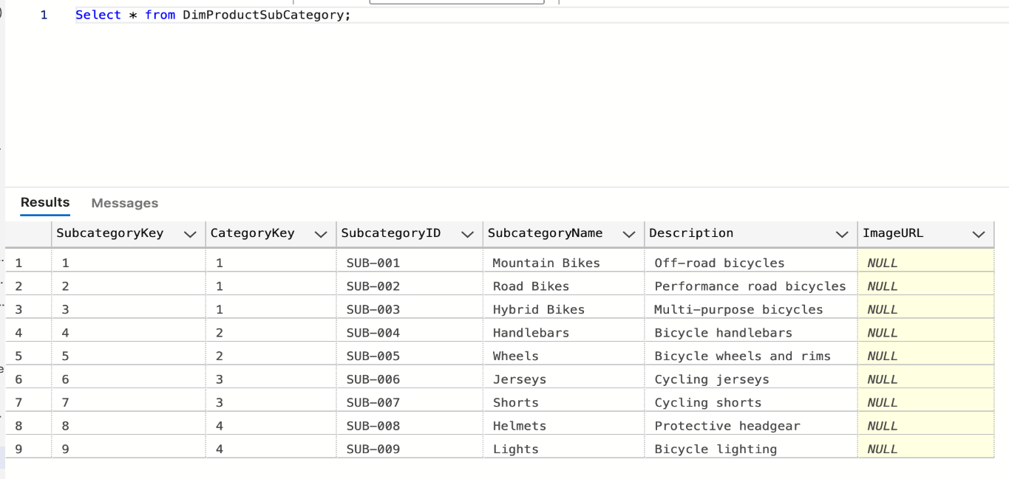
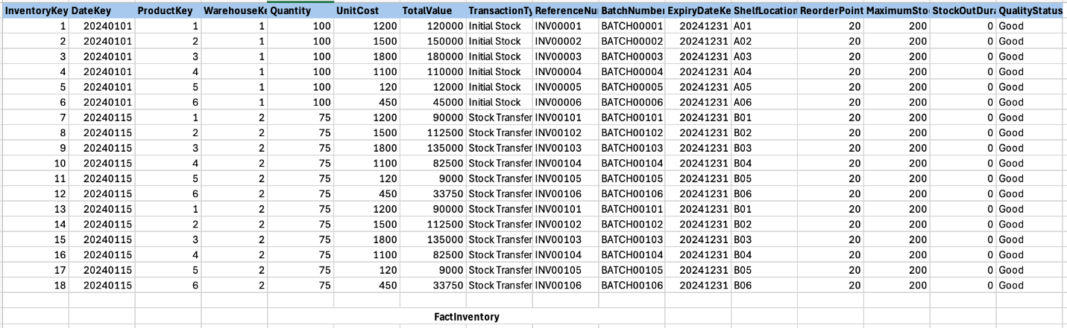
DimProductSubCategory
FactInventory

Slide 28
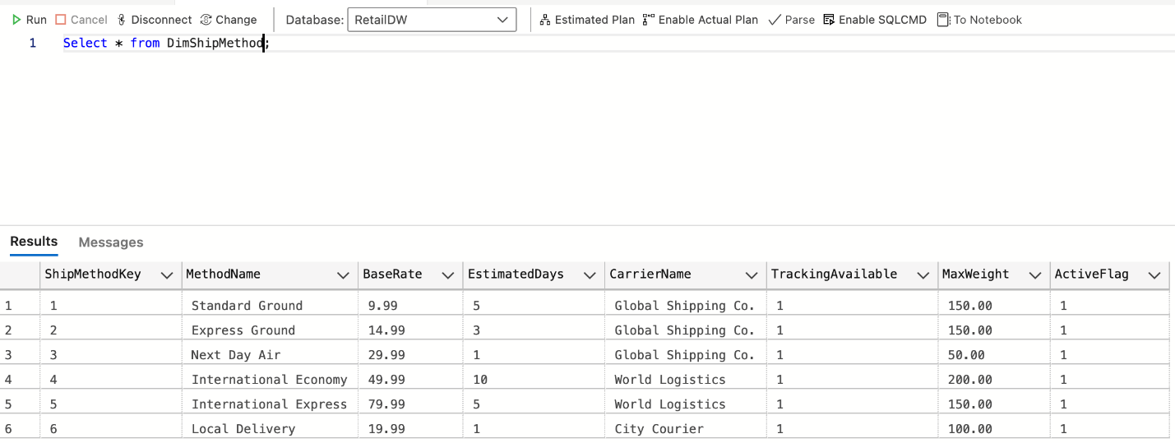
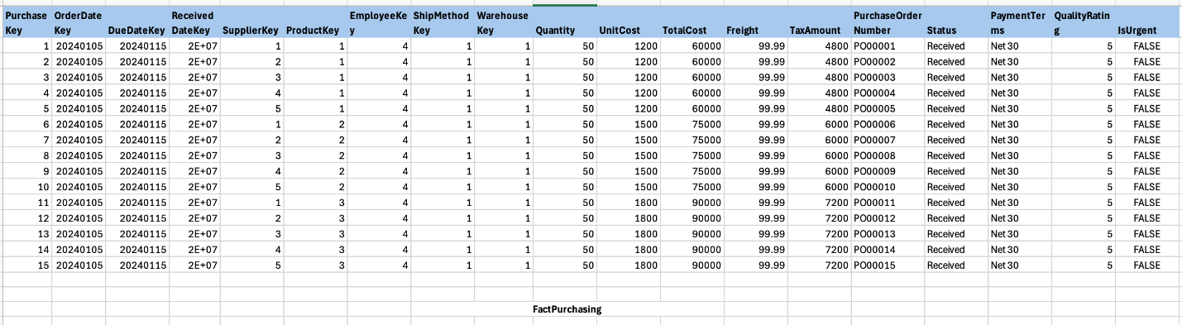
DimShipMethod
FactPurchasing

Slide 29
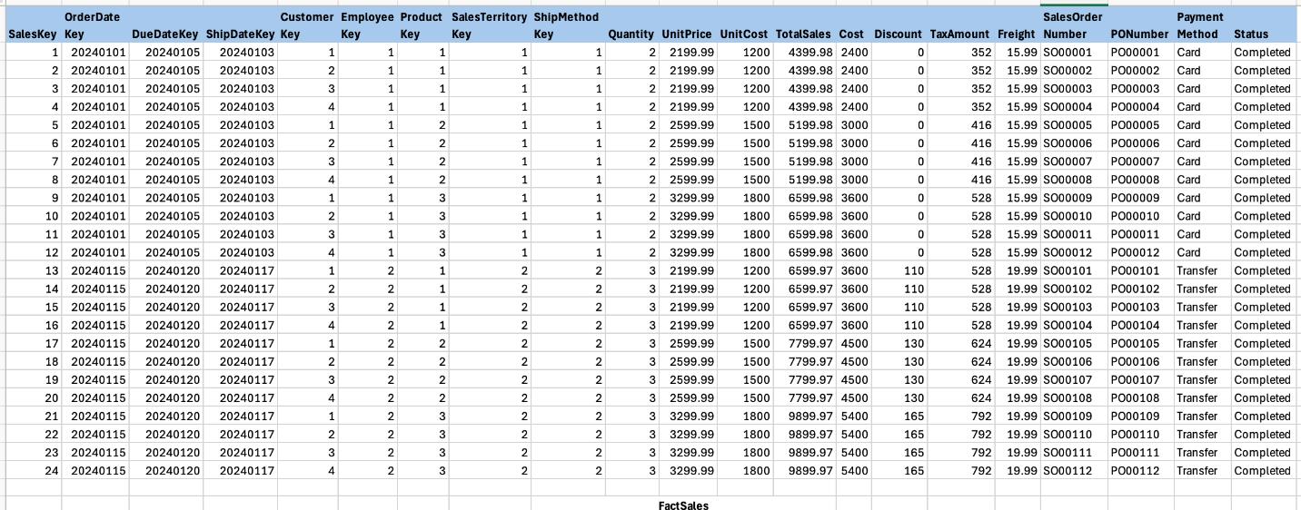
FactSales

Slide 30
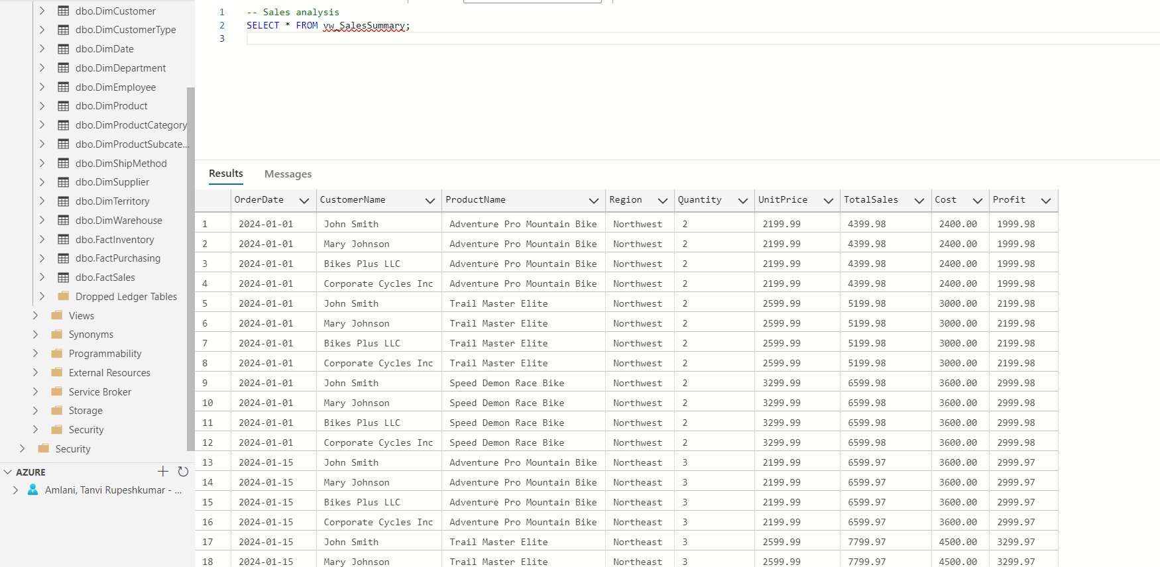
vw_SalesSummary
CREATE VIEW vw_SalesSummary
AS
SELECT
CONVERT(VARCHAR(10), d.FullDate, 120) AS OrderDate,
CONCAT(c.FirstName, ' ', c.LastName) AS CustomerName,
p.ProductName,
t.Region,
s.Quantity,
s.UnitPrice,
s.TotalSales,
s.Cost,
(s.TotalSales - s.Cost) AS Profit
FROM dbo.FactSales s
INNER JOIN dbo.DimDate d
ON s.OrderDateKey = d.DateKey
INNER JOIN dbo.DimCustomer c
ON s.CustomerKey = c.CustomerKey
INNER JOIN dbo.DimProduct p
ON s.ProductKey = p.ProductKey
INNER JOIN dbo.DimTerritory t
ON s.SalesTerritoryKey = t.SalesTerritoryKey;
GO

Slide 31
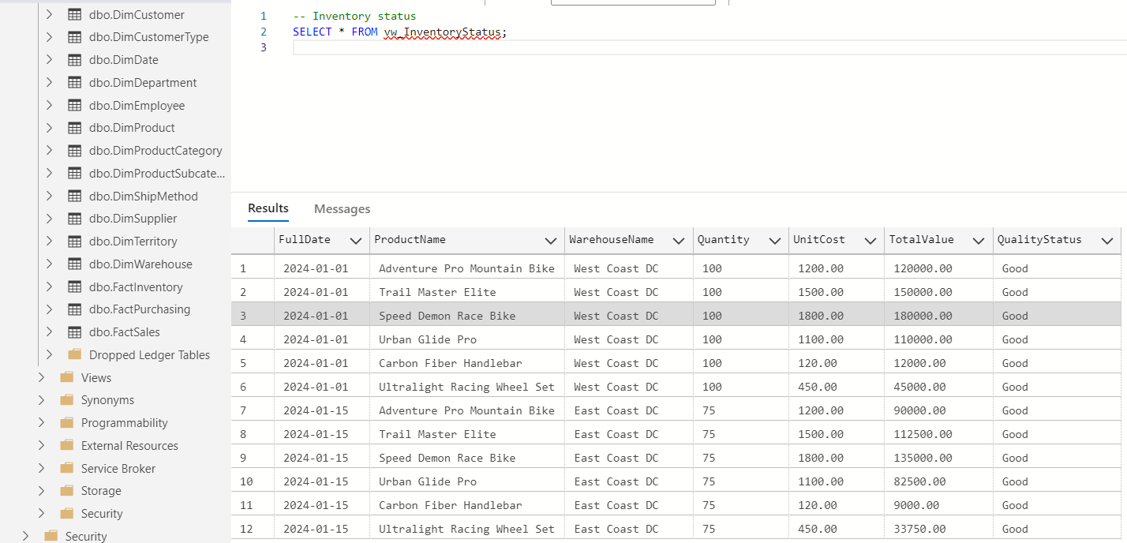
vw_InventoryStatus
CREATE VIEW vw_InventoryStatus AS
SELECT
d.FullDate,
p.ProductName,
w.WarehouseName,
i.Quantity,
i.UnitCost,
i.TotalValue,
i.QualityStatus
FROM FactInventory i
JOIN DimDate d ON i.DateKey = d.DateKey
JOIN DimProduct p ON i.ProductKey = p.ProductKey
JOIN DimWarehouse w ON i.WarehouseKey = w.WarehouseKey;

Slide 32
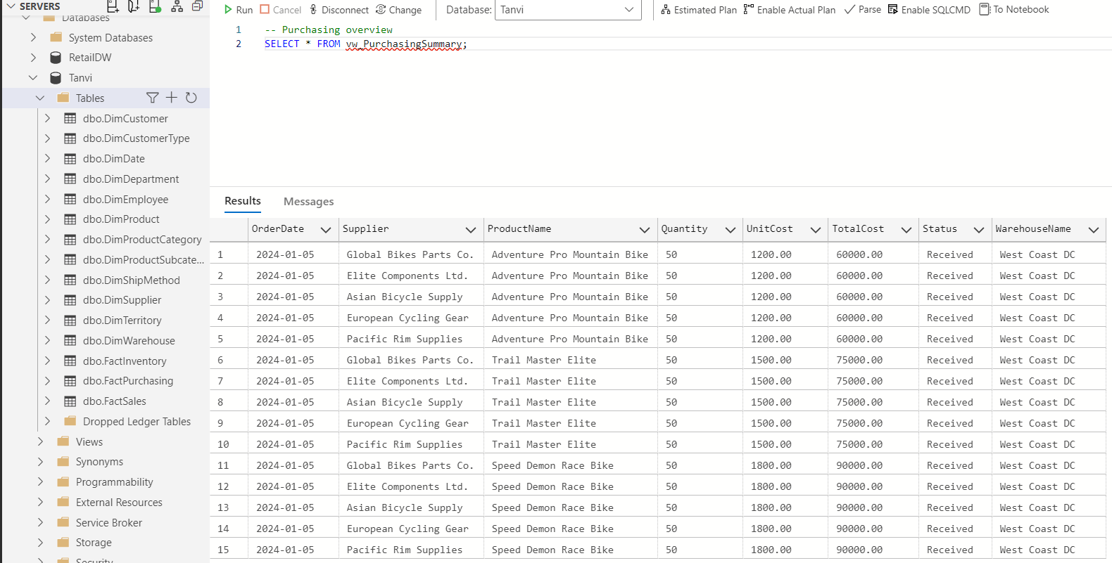
vw_PurchasingSummary
CREATE VIEW vw_PurchasingSummary AS
SELECT
d.FullDate AS OrderDate,
s.CompanyName AS Supplier,
p.ProductName,
fp.Quantity,
fp.UnitCost,
fp.TotalCost,
fp.Status,
w.WarehouseName
FROM FactPurchasing fp
JOIN DimDate d ON fp.OrderDateKey = d.DateKey
JOIN DimSupplier s ON fp.SupplierKey = s.SupplierKey
JOIN DimProduct p ON fp.ProductKey = p.ProductKey
JOIN DimWarehouse w ON fp.WarehouseKey = w.WarehouseKey;

Slide 33
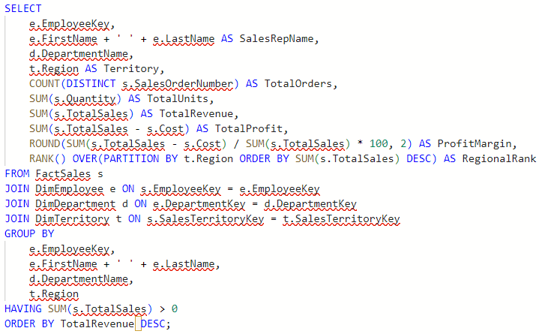
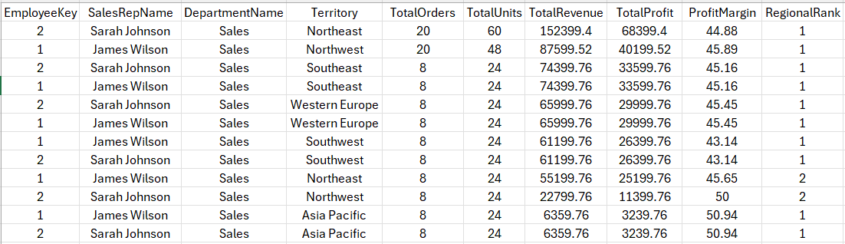
Top Sales Representative Analysis

Slide 34
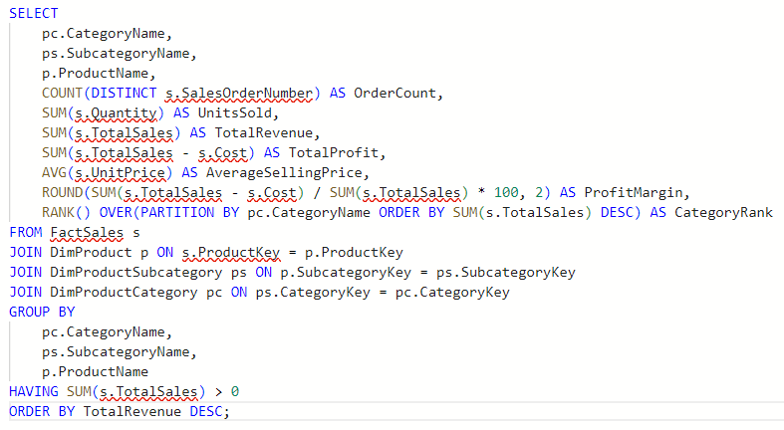
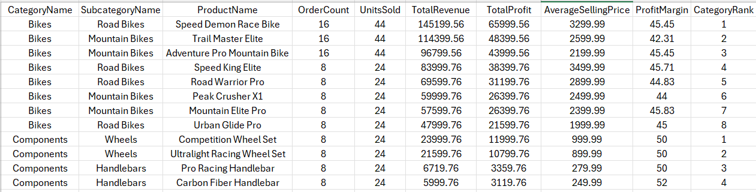
Product category performance

Slide 35
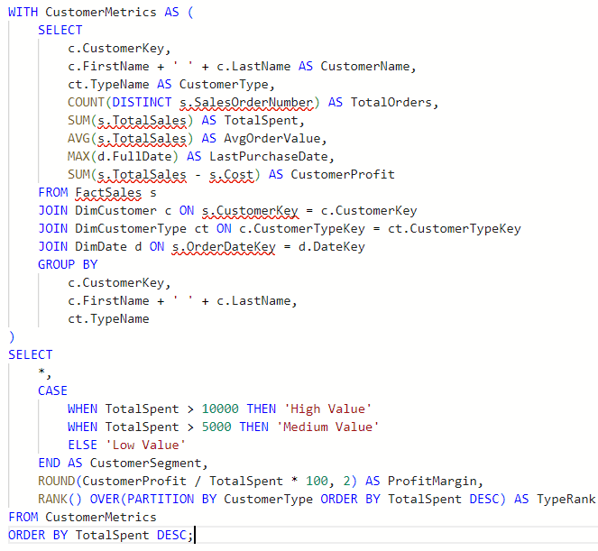
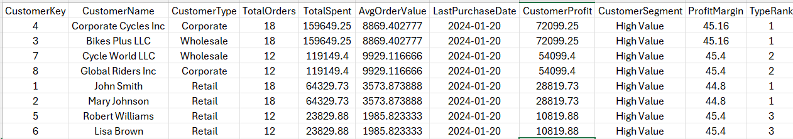
Customer Segmentation Analysis

Slide 36
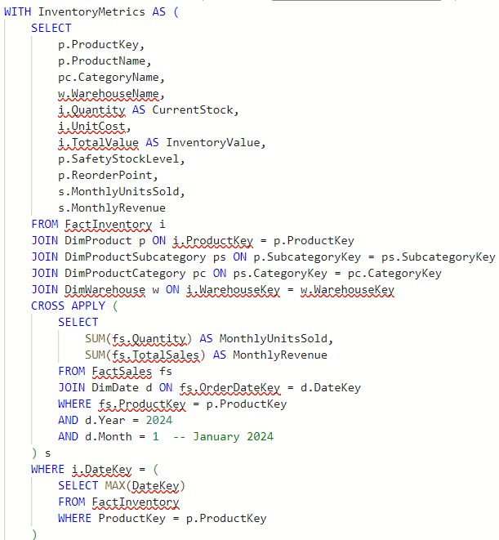
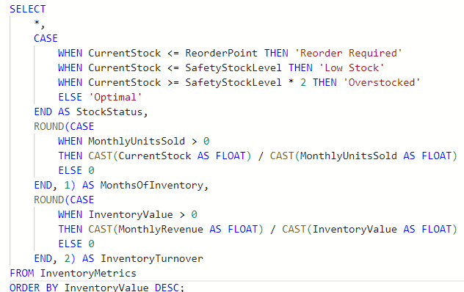
Inventory and Stock Analysis

Slide 37
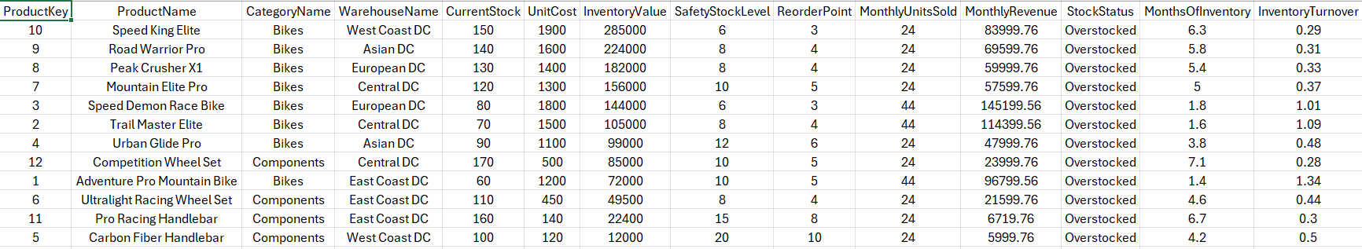
Inventory and Stock Analysis

Slide 38
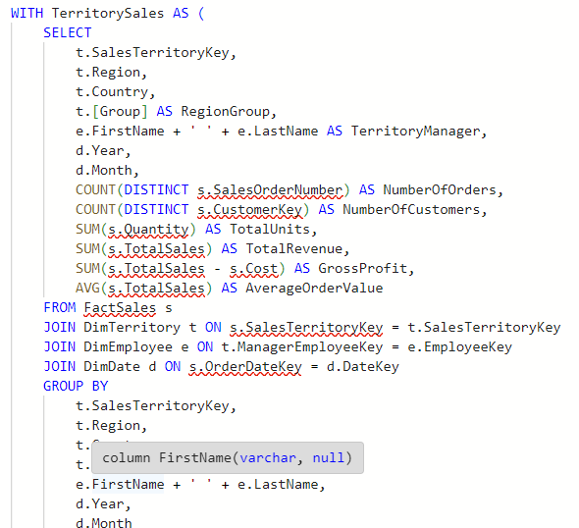
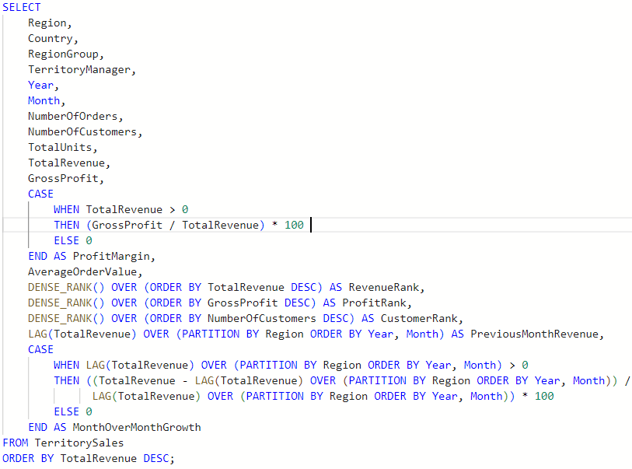
Regional Sales Performance

Slide 39
Regional Sales Performance

Slide 40
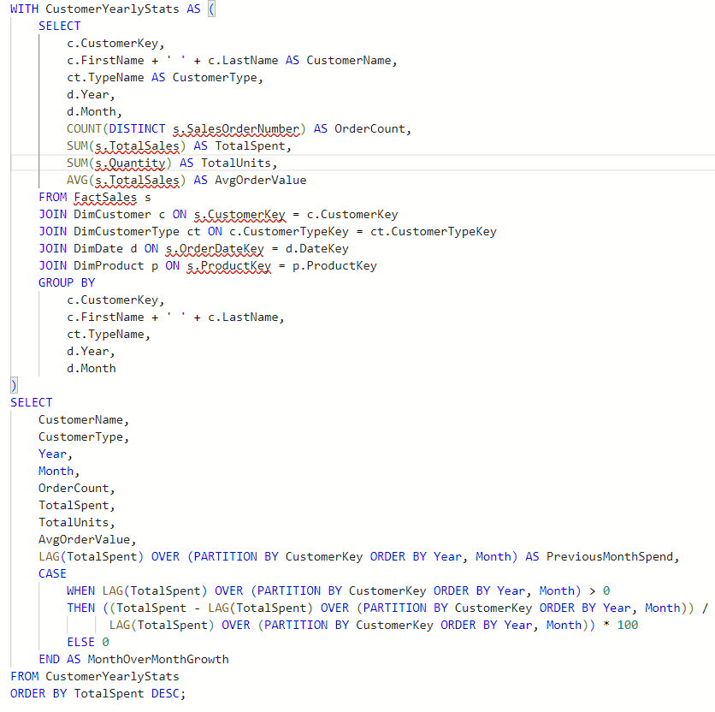
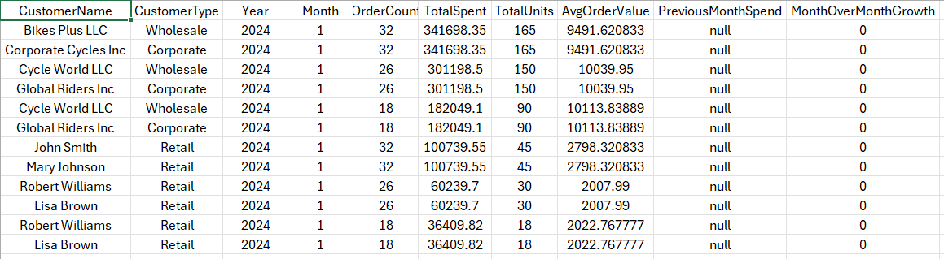
Customer Purchase Pattern Analysis

Slide 41
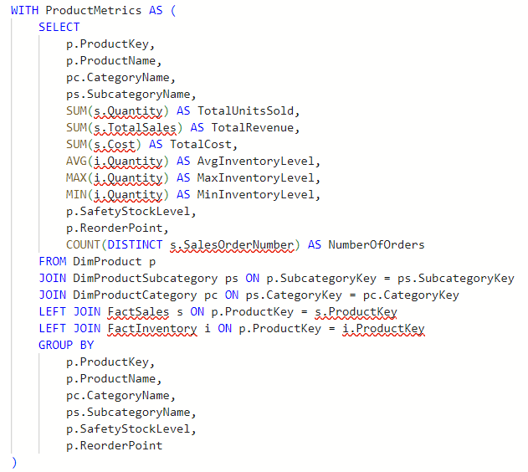
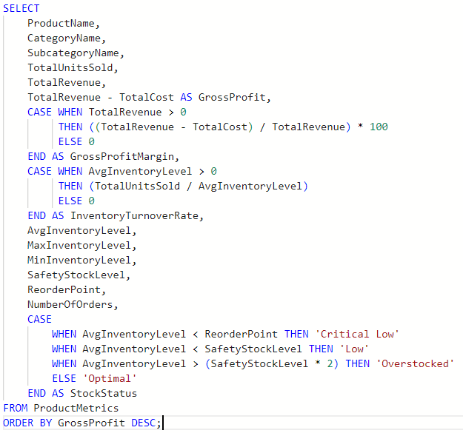
Product Profitability and Inventory Efficiency

Slide 42
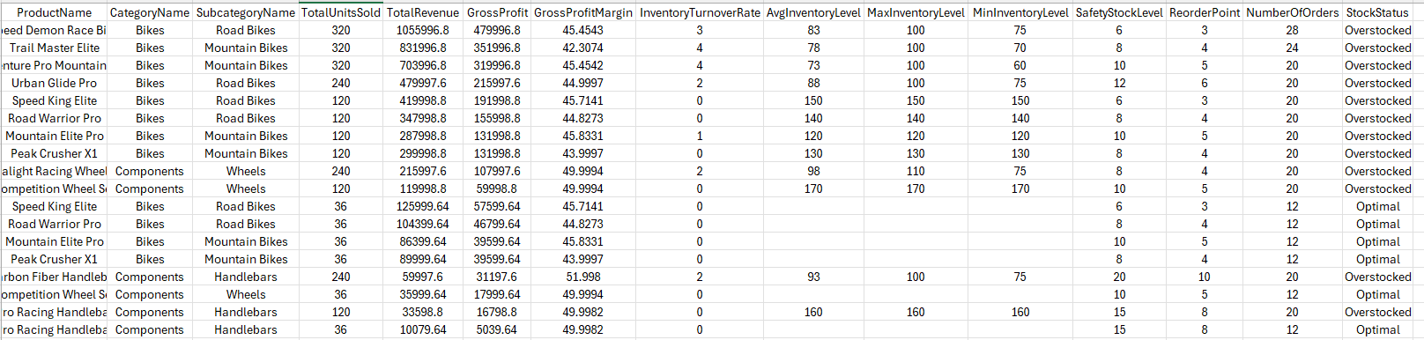
Product Profitability and Inventory Efficiency

Slide 43
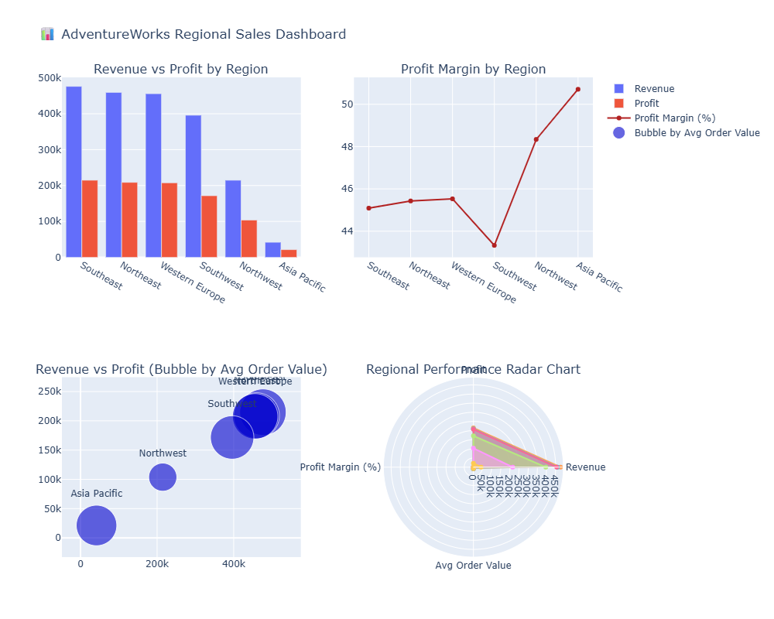
Product Profitability and Inventory Efficiency

Slide 44
Considerations
Scalability
Design the model to accommodate future growth in data volume
Performance
Balance normalization with query performance requirements
Implement appropriate indexing, especially on foreign key columns in the fact table
Consider partitioning the Sales fact table for large volumes of data
Flexibility
Allow for potential additions of new data elements or relationships
The current design supports easy addition of new dimensions or fact tables
Data Quality
Implement checks and constraints to ensure data accuracy and consistency
Consider implementing a system to track data lineage

Slide 45
Future Expansion
Integration with ETL (Extract, Transform, Load) processes
Connection to business intelligence and reporting tools
Expansion to include additional data sources or business areas
Implement a full-fledged Date dimension to enhance time-based analysis capabilities

Slide 46
Thankyou

